Slide 1

Case Study Scenario: FastCar Racing Inc. aka.ms/FastCarCase

Slide 2
PaaS Services Case Study
https://pdtitlabsstorage.blob.core.windows.net/azureadvanced/ PAASCaseStudy.pdf

Slide 3
The Exam Prep Series Case Study Scenario: FastCar Racing Inc.
From the green flag to the checkered flag, it takes a lot of technology horsepower to bring the spectacle of a FastCar Racing Inc. race to life. To unify its race control systems and help make every race entertaining, fair, and safe, FastCar Racing Inc. is undergoing a full digital transformation of its IT landscape.
FastCar Racing Inc. is looking for ways to make better race decisions, promote safety innovation, find new ways to engage content-hungry fans, and continue doing business at 200 miles an hour.

Slide 4
The Exam Prep Series Case Study Scenario: FastCar Racing Inc.
FastCar Racing Inc. outlined a hybrid cloud migration strategy, which it wants to see accomplished between now and the next 1-2 years. By the end of 2021, it wants to have shut down its on-premises datacenters completely.
Microsoft Azure has been chosen as future public cloud platform. A good combination of IaaS, PaaS and SaaS solutions will be part of this future platform, together with 3rd party SaaS applications.
Your first task is outlining the different architectural designs, as well as identifying the different Azure services to be used.

Slide 5
The Exam Prep Series Case Study Scenario: FastCar Racing Inc.
Overall Business Requirements:
All application workloads, whether IaaS, PaaS or SaaS, should have an SLA of at least 99.9%
All current running solutions having a recent Operating System (max. 5 years old), could be migrated using Lift & Shift
Where possible and beneficial, PaaS or SaaS should be used
Data can be stored globally, with a preference for US and EU as region locations
All connectivity involving administrative management of systems and applications, is only allowed using a secure connection

Slide 6
The Exam Prep Series Case Study Scenario: FastCar Racing Inc.
Business Requirements:
The public-facing website, developed in .NetCore with a SQL database back-end only 2 years ago, should be available 24/7, especially during racing-season
Based on historical log data, it should be able to handle 1,2 million user connections from all over the world. Users should not experience high latency, to optimize the experience and expose the core of the company, being fast
No downtime is allowed during racing events, as it immediately harms the business
The website gets updated about 3x per week, and the process is “right-click / publish” today. Can we optimize this?

Slide 7
The Exam Prep Series Case Study Scenario: FastCar Racing Inc.
Business Requirements:
About 40% of current fans user requests, always have the same subject, racing schedule and information on the racing pilots and teams. Fastcar Racing Inc. is interested in exploring any AI, linguistic and bot-alike services in this domain, allowing for increasing customer satisfaction, lowering the amount of work on the administrative back-end for handling these requests.

Slide 8
The Exam Prep Series Case Study Scenario: FastCar Racing Inc.
Business Requirements:
In the near future, all racing cars should become ‘smart cars”, using IOT as the technical enabler of logging all traceable data of a car in action. Together with Machine Learning, this will allow FastCar Racing Inc. to make racing even better, more enjoyable, cost efficient,… relying on near-realtime feedback from each car.

Slide 9
The Exam Prep Series Case Study Scenario: FastCar Racing Inc.
Technical Requirements:
Everything should be set up according to Microsoft best practices, using Azure Services that are generally available.
To accommodate the business requirements, internal IT knows it has to leverage on the investment made the last few years around scripting and automation. Where possible, DevOps should be integrated in their overall way-of-operating.
Each corporate user gets a company laptop and mobile phone, allowing for remote working. Security solutions need to be put in place to only allow Azure Active Directory with extensive security and identity capabilities as authentication mechanism to these devices.

Slide 10
The Exam Prep Series Case Study Scenario: FastCar Racing Inc.
Technical Requirements:
IT is currently operational 24/7, using an 8h business day concept across 3 different continents. At present, all sysadmins have access to all IT server assets, no matter where they are running. This has often led to unforeseen downtime of systems, or having seen changes been pushed to production, without always being able to detect who made those changes. This should be optimized and be more controlled in who can deploy what
Having an affordable dev/testing environment would be beneficial

Slide 11
The Exam Prep Series Case Study Scenario: FastCar Racing Inc.
Technical Requirements:
An end-to-end operations tooling and monitoring should be put in place. First of all allowing for a real-time view on current IT workloads, uptime and alerting for Azure-running resources, but later on also supporting on-premises running systems and applications into this logging solution
We lack detailed monitoring of our application landscape, and mainly “find out” afterwards or during outage what went wrong
We don’t have a solution allowing for load-testing

Slide 12
The Exam Prep Series Case Study Scenario: FastCar Racing Inc.
Technical Requirements:
FastCar Racing Inc. started a migration to Office 365 about 8 months ago. They are convinced public cloud is the way forward. Any new workload should allow for an integration with Office 365 components, whether from a technical perspective or security standpoint. About 20% of all employees have already been migrated to Office 365 (Email, Skype and SharePoint)
FastCar Racing Inc. relies on off-site tape backups for now. You need to work on a solution allowing for a similar cross-premises data storage, data retrieval and data archiving system.

Slide 13
Customer Needs
Improve the performance for customers and partners accessing the Fastcar Racing Inc. websites around the world
Support for easily provisioning resources to meet bursts of demand
Consolidate and improve the utilization of website and database hosting resources
For their most demanding databases, they want to migrate without having to re-architect their database structure or make large changes the application
Avoid downtime, particularly caused by web and database server patching
Leverage familiarity with Microsoft tools
Notes:
20535A
7: Comparing Database Options in Azure

Slide 14
Customer Objections
Scale & Performance:
I do not want to have to make code changes (or redevelop) in order to change the scale of a website
I hear Azure Web Sites is only useful for websites with small amounts of traffic; will it really support the heavy traffic we receive?
We would prefer to avoid performing a database migration (e.g., to another server) in order to scale the throughput of our database
We have heard SQL Database does not provide consistent performance, is this true?
Notes:
20535A
7: Comparing Database Options in Azure

Slide 15
Customer Objections
Business Continuity:
How can we be certain our data will survive in the event of a catastrophe in a certain part of the world?
We need to be able to recover from mistakes made by administrators that accidentally delete production data (we know they happen, we would love an “undo”)
Do we need to have multiple web server instances for each property to have a high SLA?
Notes:
20535A
7: Comparing Database Options in Azure

Slide 16
Customer Objections
Tool Familiarity:
Will we need to learn new tools to develop for Azure Websites and SQL Database?
What about diagnosing problems? Are there new tools we need purchase and learn?
Connectivity:
Some of our enterprise web services need to access data and other services located on-premises, is this supported?
How can we ensure we are delivering the lowest latency possible to our website visitors?
We need to ensure that if we have multiple web servers backing a given website, that no one web server gets all the traffic
Notes:
20535A
7: Comparing Database Options in Azure

Slide 17
Customer Objections
Management:
We would prefer not to have to manage patching of web servers and databases
With all of our websites and databases around the world, how do we keep tabs on which is up and which is down and which is struggling?
We need a simple solution to schedule and automate backup of the website and database
Notes:
20535A
7: Comparing Database Options in Azure

Slide 18
Customer Objections
Security:
Is it possible to allow our visitors to use a mix of legacy and modern browsers and still provide for secure transactions?
What does Azure offer to help us with auditing access to our web servers and databases?
Our staff is accustomed to accustomed to a single sign-on experience — will this still be possible?
Notes:
20535A
7: Comparing Database Options in Azure

Slide 19
Happy Case-Studying ☺

Slide 20
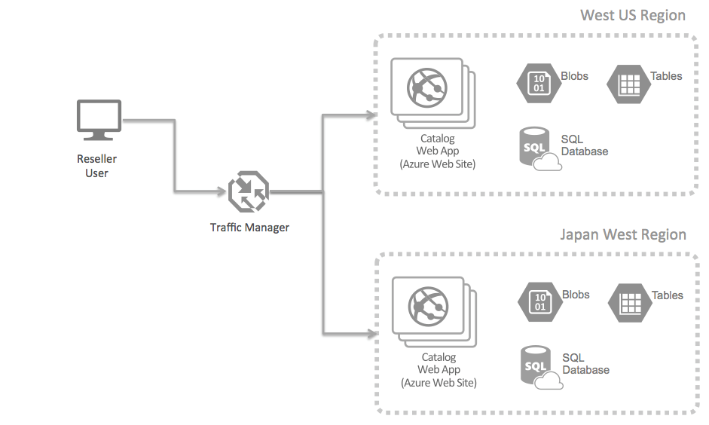
Potential Solution
Web Application Hosting
Azure US Region
FastCar Racing Inc
Azure EU Region
Notes:
The PoC scenario would be to address the latency issue faced by resellers around the world that currently rely on to access the Utah datacenter. The PoC would address showing how by using Azure Traffic Manager along with Azure Web Sites in multiple regions, one can ensure that these users are always being routed to the Web Site that is “closest” to them in terms of minimizing network latency. The PoC could demonstrate this by provisioning a representative portion of the Product Catalog web application in an Azure Website, along with the storage required for it (e.g., Blob Storage, Table Storage and SQL Database) in the West US region, and then also provisioning the same infrastructure in the Japan West region. Traffic Manager would then be configured to route traffic using the Performance load balancing method.
To complete the PoC, either Adventure Works staff or resellers located near each region could be asked to visit the PoC reseller web site, measure their experience (e.g., page load times, time to first paint, etc.) and report on the perceived performance (e.g., does it feel more responsive than the current site?).
20535A
7: Comparing Database Options in Azure

Slide 21
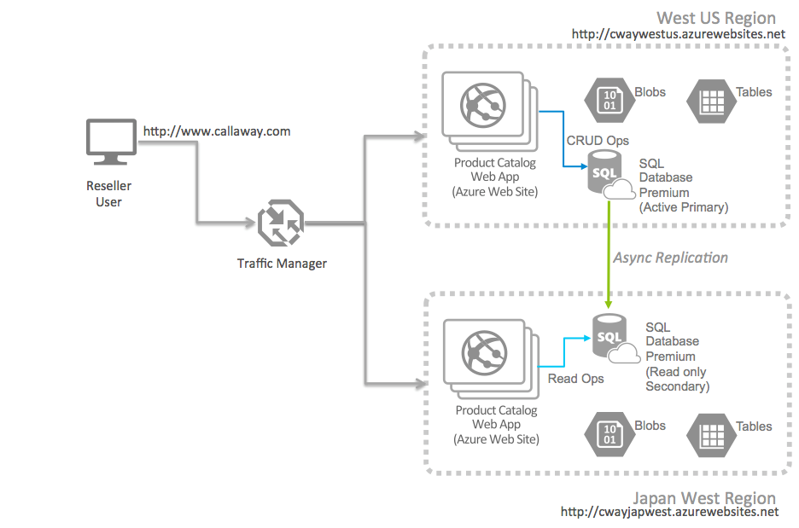
Potential Solution
Database Queries & Sync
Azure US Region
FastCar Racing Inc
Azure EU Region
Notes:
On the database side, the PoC should be augmented to use the SQL Database Premium tier. The PoC would address showing using SQL Database Premium along with Azure Web Sites in multiple regions, whereby one configures SQL Database Premium to provide Active Geo-Replication across two regions (West US and Japan West as examples). SQL Database Premium could be configured with the primary in the West US Region, and a readable replica available in the Japan West Region.
By approaching it this way, the PoC could explore the benefits of accessing read-only data from the database nearest the Web Site, while reserving data modifications operations for the active primary database instance.
To complete the PoC, Adventure Works could simulate a regional failure and switch to using the SQL Database in the Japan West region as the active primary. They could go one step further and stop the Web Sites in the West US region and thereby simulate a complete regional failure of the West US region. By having Traffic Manager in place, all traffic would flow to the Japan West Region, and the active database would be in that region as well.
20535A
7: Comparing Database Options in Azure

Slide 22
Benefits
Scalability & Agility:
Can respond to requests and implement features much quicker than in the past
Easy to setup infrastructure in other geographies
Performance & Availability:
Avoid maintenance-related downtime
Update regional servers in isolation from other global locations/offices
Notes:
Improve Scalability and Agility
Adventure Works has gained a level of IT scalability and agility that it never before had.
Cowles’s team can respond much faster to requests for IT resources. “With Azure, we can respond to business requests in hours versus the months that it took before,” Cowles says. “It’s especially valuable in responding to requests in non-US regions, because it’s difficult to set up infrastructure in Carlsbad and provide remote access to those applications.”
Enhance Performance and Availability of Core Business Systems
Since moving important pieces of its infrastructure to Azure, Adventure Works has enjoyed higher overall availability of critical applications and web properties. “With Azure, we no longer have maintenance-related downtime that negatively affects our business around the world,” Cowles says.
By migrating its business-to-business website to Microsoft Azure, Adventure Works will eliminate the cost of that on-premises infrastructure and also realize reliability and performance gains. “It’s a lot easier to load-balance virtual machines in Azure than physical servers in our datacenter,” Cowles says. “We can also mitigate the impact of server security updates. By moving the B2B infrastructure to Azure, we can apply updates only to the regional servers that need them without affecting uptime in all of our offices.”
20535A
7: Comparing Database Options in Azure

Slide 23
Customer Needs
Improve the performance for customers and partners accessing the Fastcar Racing Inc. websites around the world
Support for easily provisioning resources to meet bursts of demand
Consolidate and improve the utilization of website and database hosting resources
For their most demanding databases, they want to migrate without having to re-architect their database structure or make large changes the application
Avoid downtime, particularly that caused by web and database server patching
Leverage familiarity with Microsoft tools
Notes:
20535A
7: Comparing Database Options in Azure

Slide 24
Customer Objections
Scale & Performance:
I do not want to have to make code changes (or re-deploy) in order to change the scale of a website Web App AutoScale
I hear Azure Web Sites is only useful for websites with small amounts of traffic; will it really support the heavy traffic we receive? Select Premium Web App Plan
We would prefer to avoid performing a database migration (e.g., to another server) in order to scale the throughput of our database SQL DB Scaling
We have heard SQL Database does not provide consistent performance, is this true? SQL DTU Plan
Notes:
20535A
7: Comparing Database Options in Azure

Slide 25
Customer Objections
Business Continuity:
How can we certain our data will survive in the event of a catastrophe in a certain part of the world? HA for SQL DB + Web App with Traffic Manager
We need to be able to recover from mistakes made by administrators that accidentally delete production data (we know they happen, we would love an “undo”) Web App Deployment Slots, SQL Backup
Do we need to have multiple web server instances for each property to have a high SLA? Web Apps delivers a 99.95% SLA
Notes:
20535A
7: Comparing Database Options in Azure

Slide 26
Customer Objections
Tool Familiarity:
Will we need to learn new tools to develop for Azure Websites and SQL Database? NO
What about diagnosing problems? Are there new tools we need purchase and learn? Built-in
Connectivity:
Some of our enterprise web services need to access data and other services located on-premises, is this supported? VNET ROUTING
How can we ensure we are delivering the lowest latency possible to our website visitors? Traffic Mgr
We need to ensure that if we have multiple web servers backing a given website, that no one web server gets all the traffic Web App Service Plans
Notes:
20535A
7: Comparing Database Options in Azure

Slide 27
Customer Objections
Management:
We would prefer not to have to manage patching of web servers and databases It’s PAAS, you don’t manage the systems
With all of our websites and databases around the world, how do we keep tabs on which is up and which is down and which is struggling? Log Analytics & App Insights
We need a simple solution to schedule and automate backup of the website and database Built-in
Notes:
20535A
7: Comparing Database Options in Azure

Slide 28
Customer Objections
Security:
Is it possible to allow our visitors to use a mix of legacy and modern browsers and still provide for secure transactions? Sure, although Azure AD has some requirements and doesn’t support legacy browsers
What does Azure offer to help us with auditing access to our web servers and databases? Azure AD auditing and Identity Protection; if using other Identity providers, check their capabilities
Our staff is to a single sign-on experience — will this still be possible? Azure AD relies on Oauth and OpenIDConnect, supports ADFS or other Federation too, which all offer SSO
Notes:
20535A
7: Comparing Database Options in Azure

